Slide 1
Writing clean code (part 2)
Doan Trung Tung, PhD

Slide 2
Function

Slide 3
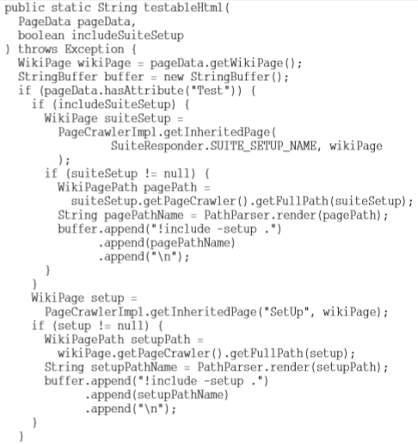
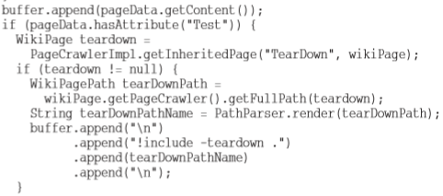
Size does matter: small is better
What is easier to understand?
A function of 50 lines of code
5 functions of 10 lines of code
Notes:
Bẻ bó đũa
Chia để trị

Slide 4
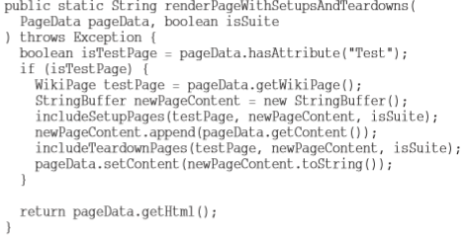
Size does matter: small is better
What is easier to understand?
A function of 50 lines of code
5 functions of 10 lines of code
Notes:
Bẻ bó đũa
Chia để trị

Slide 5

Size does matter: small is better
Rules of functions:
Function should be small
Function should be smaller than above!
150 characters / line
20 lines / function

Slide 6
Size does matter: small is better
How short should a function be? In 1999 I went to visit Kent Beck at his home in Oregon. We sat down and did some programming together. At one point he showed me a cute little Java/Swing program that he called Sparkle. It produced a visual effect on the screen very similar to the magic wand of the fairy godmother in the movie Cinderella. As you moved the mouse, the sparkles would drip from the cursor with a satisfying scintillation, falling to the bottom of the window through a simulated gravitational ﬁeld. When Kent showed me the code, I was struck by how small all the functions were. I was used to functions in Swing programs that took up miles of vertical space. Every function in this program was just two, or three, or four lines long. Each was transparently obvious. Each told a story. And each led you to the next in a compelling order. That’s how short your functions should be!
Notes:
Bẻ bó đũa
Chia để trị

Slide 7
Do one thing!
How many “things” this function does?
Functions should do one thing
They should do it well
They should do it only
1. Determining whether the page is a test page.
2. If so, including setups and teardowns.
3. Rendering the page in HTML.
TO RenderPageWithSetupsAndTeardowns, we check to see whether the page is a test page and if so, we include the setups and teardowns. In either case we render the page in HTML.
Notes:
In python, function starts with def

Slide 8
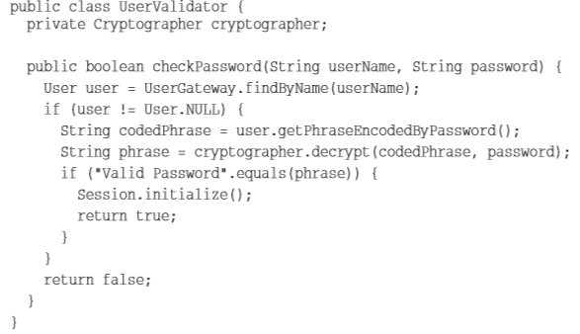
Do one thing!
Spot the “side effect”

Slide 9
Do one thing!
Functions should either do something or return something, but not both!
bool set(String attribute, String value);
if (set("username", "unclebob"))...
WTF is that?
if (attributeExists("username")) {
setAttribute("username", "unclebob");
...
}

Slide 10
One level of abstraction per function
Mixing levels of abstraction within a function is always confusing
public:
static string testableHTML(…) {
…
//
String pagePathName = PathParser.render(pagePath);
…
//
getHtml();
…
//
buffer.append("\n")
….
}

Slide 11
One level of abstraction per function
Mixing levels of abstraction within a function is always confusing
public:
static string testableHTML(…) {
…
// intermediate level of abstraction
String pagePathName = PathParser.render(pagePath);
…
// high level of abstraction
getHtml();
…
// remarkably low level
buffer.append("\n")
….
}

Slide 12
Stepdown rule
Reading from Top to Bottom
Functions should be followed by those at the next level of abstraction
To include the setups and teardowns, we include setups, then we include the test page content, and then we include the teardowns.
To include the setups, we include the suite setup if this is a suite, then we include the regular setup.
To include the suite setup, we search the parent hierarchy for the “SuiteSetUp” page and add an include statement with the path of that page.
To search the parent. . .
Notes:
It turns out to be very difﬁcult for programmers to learn to follow this rule and write functions that stay at a single level of abstraction. But learning this trick is also very important. It is the key to keeping functions short and making sure they do “one thing.” Making the code read like a top-down set of TO paragraphs is an effective technique for keeping the abstraction level consistent.

Slide 13
Function arguments: few is better
Rules of function arguments:
Functions should have few number of arguments
Functions should have fewer number of arguments than above!
Why?
Arguments maybe in a different level of abstraction
includeSetupPage() vs includeSetupPageInto(newPage)
Arguments make testing harder
1 argument: n tests
2 arguments: n x m tests
3 arguments: n x m x p tests
How
write more functions!
group arguments

Slide 14
Function arguments: fewer is better
Avoid output arguments!
Avoid flag argument
render(boolean isSuite) => render(true)
renderForSuite()
renderForSingle()
StringBuffer includeSetupPage() {
StringBuffer newPage;
….
return newPage;
}
void includeSetupPageInto(StringBuffer &newPage) {
….
}
WTF is that?
Notes:
Replace true = constant

Slide 15
Other function rules
Don’t repeat yourself!
Whenever you starts writing some duplicate codes => refactoring
Ask yourself “Does this code will be repeated” before writing
Structured programming (Dijkstra)
Every function should have one entry and one exit
only one return statement
no break, no continue, no goto
It won’t affect on small functions!

Slide 16
Exercise 2.1
Modify / refactor codes of the program “Who is millionaire”
Keep functions small, do one thing only
Codes must be in the same level of abstraction
As fewer arguments as possible
Avoid output arguments, flag arguments

Slide 17
Thinking before writing

Slide 18
Design before coding
First think, then speak
Second thoughts are best
Think today, speak tomorrow
How?
Flowcharts / Pseudo codes are for beginners!
or not?

Slide 19
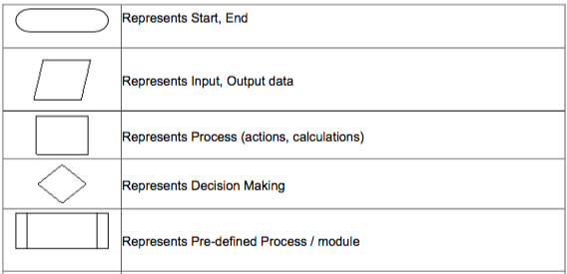
Flowcharts / Pseudo code (revision)

Slide 20
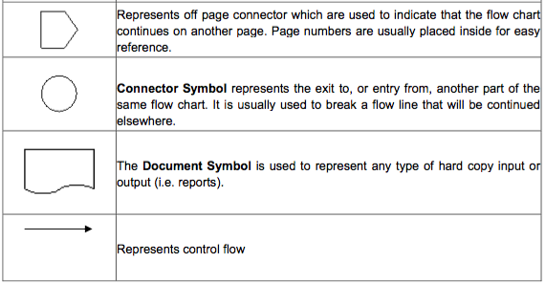
Flowcharts / Pseudo code (revision)

Slide 21
Comment before coding
void Program::play() {
// first, tell bank to load questions
// say hello
// ask user name then welcome
// loop until game is over
// MC ask question (get from the bank)
// MC tells player to answer
// MC check answer
// MC increases score if correct answer
// tell player
// MC check player win if correct answer
// if player win, quit game
// if wrong answer quit game
}
Notes:
Python language

Slide 22
Test before coding
Seriously, TEST before CODE
It has a name: Test-Driven Development (popular by XP)
Code without tests is not clean (Dave Thomas)
TDD
a method of developing software, not just testing
unit tests are developed first, before the code

Slide 23
TDD – How it works
Add a Test
Use Cases / User Stories are used to understand the requirement clearly
Run all tests and see the new one fail
Ensures test harness is working correctly
Ensures that test does not mistakenly pass
Write some code
Only code that is designed to pass the test
No additional functionality should be included because it will be untested

Slide 24
TDD – How it works
Run the automated tests and see them succeed
If tests pass, programmer can be confident code meets all tested requirements
Refactor code
Cleanup the code
Rerun tests to ensure cleanup did not break anything
Repeat [4]

Slide 25
Test First vs Test Last
Pick a piece of functionality
Write a test that expresses a small task that fails
Write production code until test passes
Run all tests
Rework code until all tests pass
Repeat
Pick a piece of functionality
Write production code that implements entire functionality
Write tests to validate all functionality
Run all tests
Rework code until all tests pass

Slide 26
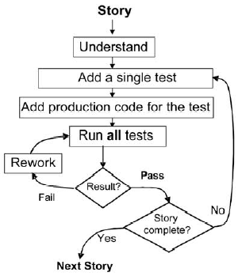
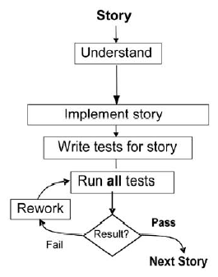
Test First vs Test Last

Slide 27
Research Study
Quality
TDD pairs’ code passed approximately 18% more test cases than the control groups
TDD practices appear to yield code with superior external quality [2]
Productivity
TDD programmers took approximately 16% more time than the control group programmers
Code Coverage
TDD programmers test cases achieved a mean of 98% method, 92% statement and 97% branch coverage
George, Boby; Williams, Laurie. A Structured experiment of test-driven development. 2003.
Notes:
Industry standard coverage is in the range of 80-90%

Slide 28
TDD Benefits
Instant Feedback
Developer knows instantly if new code works and if it interferes with existing code
Better Development Practices
Encourages the programmers to decompose the problem into manageable, formalized programming tasks
Provides context in which low-level design decisions are made
By focusing on writing only the code necessary to pass tests, designs can be cleaner and clearer than is often achieved by other methods

Slide 29
TDD Benefits
Quality Assurance
Having up-to-date tests in place ensures a certain level of quality
Enables continuous regression testing
TDD practices drive programmers to write code that is automatically testable
Whenever a software defect is found, unit test cases are added to the test suite prior to fixing the code

Slide 30
TDD Benefits (3 of 3)
Lower Rework Effort
Since the scope of a single test is limited, when the test fails, rework is easier
Eliminating defects early in the process usually avoids lengthy and tedious debugging later in the project
“Cost of Change” is that the longer a defect remains the more difficult and costly to remove

Slide 31

Exercise 2.2
Develop MyList class using TDD

Slide 32
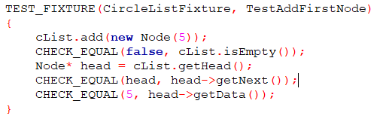
Exercise 2.2
Develop MyList class using TDD

Slide 33
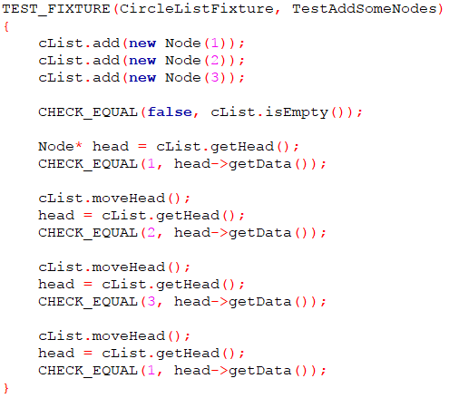
Exercise 2.2
Develop MyList
class using TDD

Slide 34
Further reading
UnitTest++: https://github.com/unittest-cpp/unittest-cpp/wiki/Macro-and-Parameter-Reference
TDD example with UnitTest++: https://github.com/unittest-cpp/unittest-cpp/wiki/Writing-More-Tests-With-the-Bowling-Game-Kata

